Slide 1

Lab 4: Interfacing MPI and CUDA along with concurrent parallel constructs including OpenMP for Image Processing, Linear Algebra.
Indian Institute of Technology Gandhinagar
ES-611: Algorithms on Advanced Computer Architecture
MPI Interfacing for Code Parallelization
Team Members
Nishant N. Rao 11110059 | Ravi Kumar 11110081
Parth Gudhka 11110062 | Shashank Heda 11110094

Slide 2
Important Points
Shared memory construct for parallelization vs. the Distributed Memory Construct
Parallel Computation
Interdependency of Pixels
Pipelining X11: Not Advisable for OpenMP
Intricacies with MPI

Slide 5
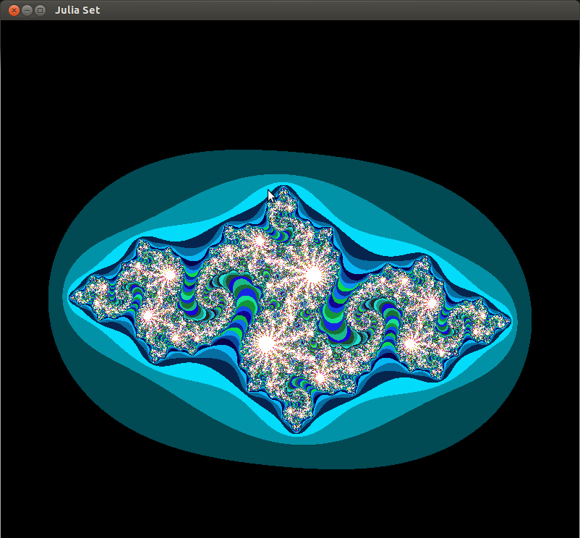

Slide 6
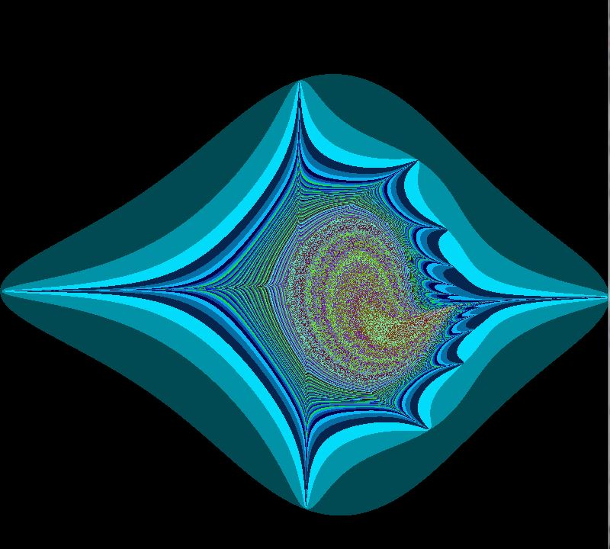

Slide 7
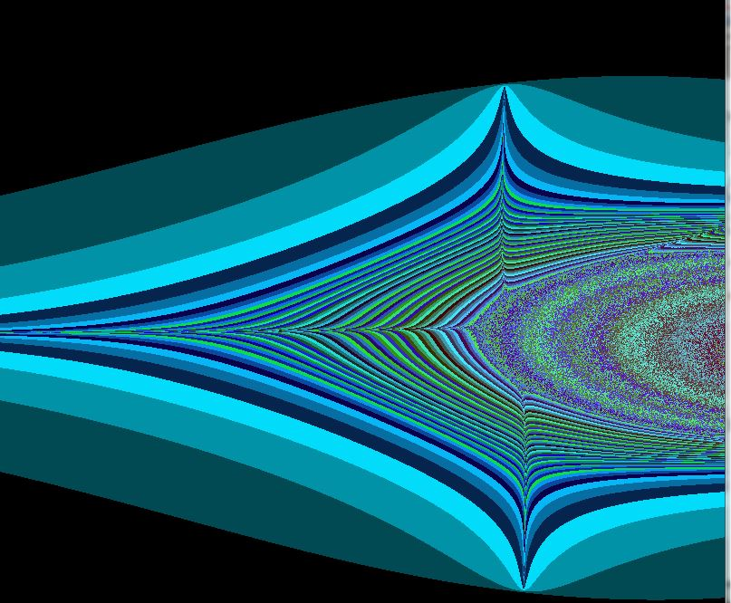

Slide 8


Slide 9
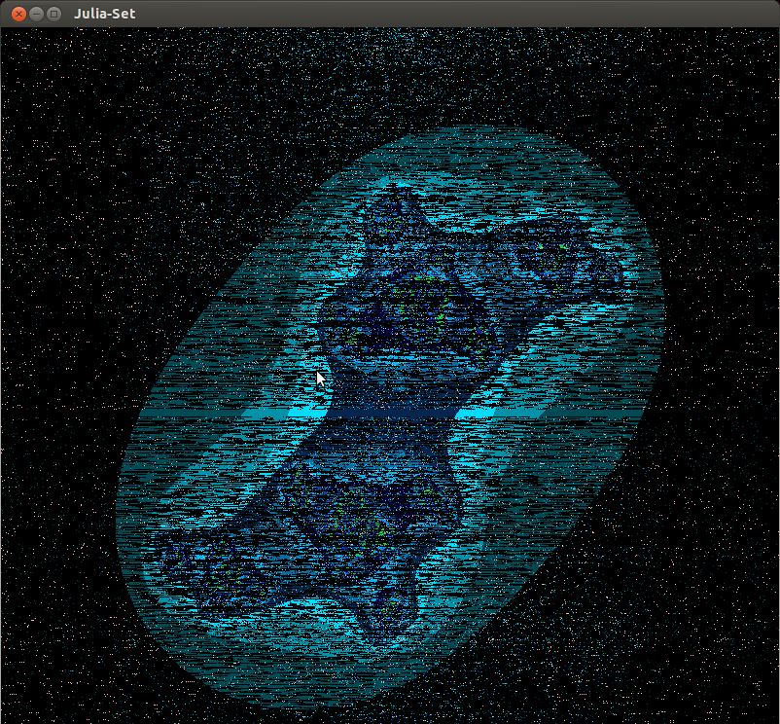

Slide 10
Some of the Observations
Parallelizing the plotting area for OpenMP: Grain-display,
However, overall time increases with increment in number of threads…
Zoom/Shifting (Z-real/Z-imag)
Why lesser time for higher imax, c?

Slide 11
m=15

Slide 12
m=256

Slide 14
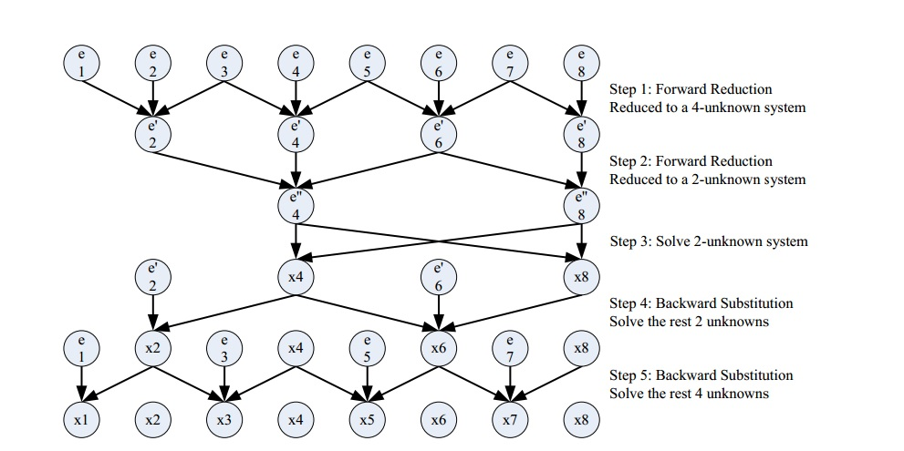
Serial Cyclic Reduction

Slide 15
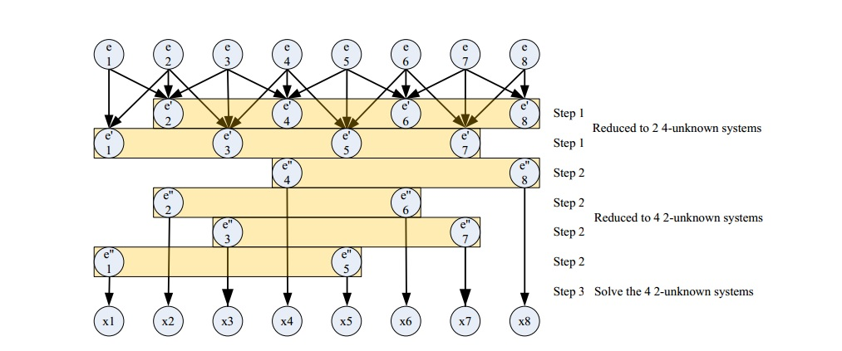
Parallel Cyclic Reduction

Slide 16
Cyclic Reduction: Serial

Slide 17
Cyclic Reduction: Parallel

Slide 20
Serial Vs. Parallel: Cyclic Reduction

Slide 21
Serial Vs. Parallel: Cyclic Reduction

Slide 22
Future Work
Theoretically, parallel cyclic reduction: supposed to more efficient than the serial code (almost half the time)
Hybrid CR+PCR solver: 60% more efficient than Cyclic Reduction

Slide 23
Future Work
Manually generated Image Rendering: Zooming in by a large scale algorithm
https://code.google.com/p/xing-cpp-lib/wiki/MandelbrotJuliaGenerator

Slide 24
Thank You

